Slide 1

How we Bootstrapped C++ and the STL Into the Linux / Windows Kernel
Rian Quinn, quinnr@ainfosec.com
Brendan Kerrigan, kerriganb@ainfosec.com

Slide 2
Overview
Bareflank aims to provide all of the scaffolding needed to rapidly prototype new hypervisors in C++. Currently Bareflank has support for Linux on Intel 64bit CPUs, but support for Windows, OS X, and UEFI is coming as well as support for ARM and AMD platforms.

Slide 3
Outline
Motivation
Why C++
Cross Compiler / Build System
Wrapper Script
Libc++
ELF Loader
C Runtime Library
Unwind Library
Commit / Rollback
Questions

Slide 4
Motivation
Too Focused On Virtual Machines
Hypervisors are used for more than virtualizing servers and running Windows on a Mac
In fact, there is a whole field of research where hypervisors are used without any guest virtual machines.
MoRE: https://github.com/ainfosec/MoRE
SimleVisor: https://github.com/ionescu007/SimpleVisor
HyperPlatform: https://github.com/tandasat/HyperPlatform
HyperBone: https://github.com/DarthTon/HyperBone

Slide 5
Motivation
Too Focused On Virtual Machines (continued)
Existing open source hypervisors focus too much on legacy support and guest virtual machines:
Xen: www.xenproject.org
KVM: http://www.linux-kvm.org/page/Main_Page
VirtualBox: https://www.virtualbox.org/wiki/Downloads
These hypervisors are painful to work with when conducting less traditional hypervisor research.
Thus researchers always start the same way, spending months standing up a hypervisor before working the actual project.

Slide 6
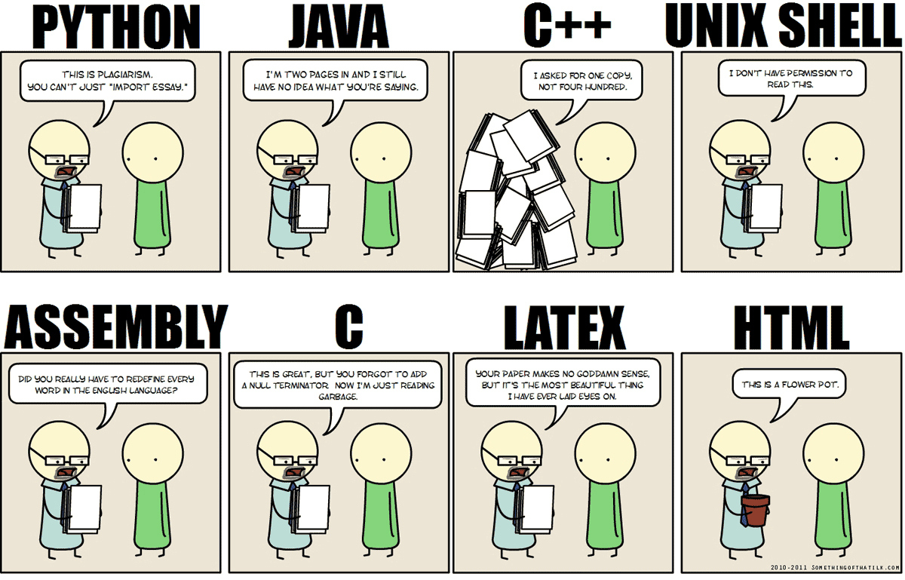
Motivation
Prototyping
Existing hypervisors don’t provide generic access to support libraries for fast prototyping (the never ending battle between C / C++)

Slide 7
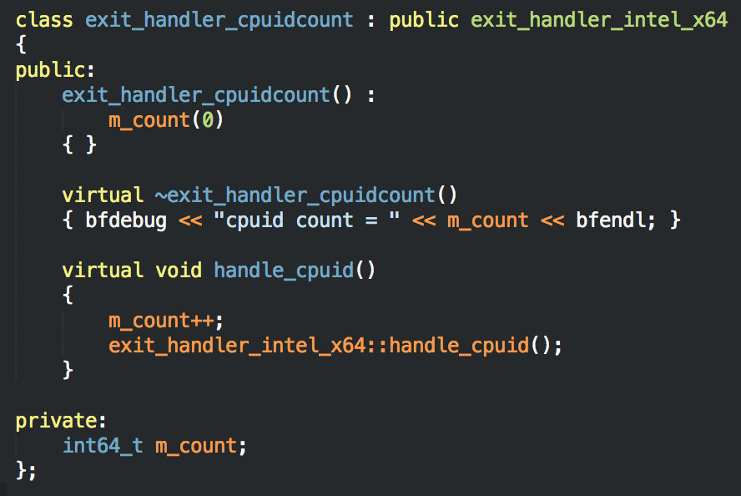
Why C++
Inheritance
Using C++ inheritance, Bareflank provides a clear method for extending the base hypervisor to add additional functionality

Slide 8
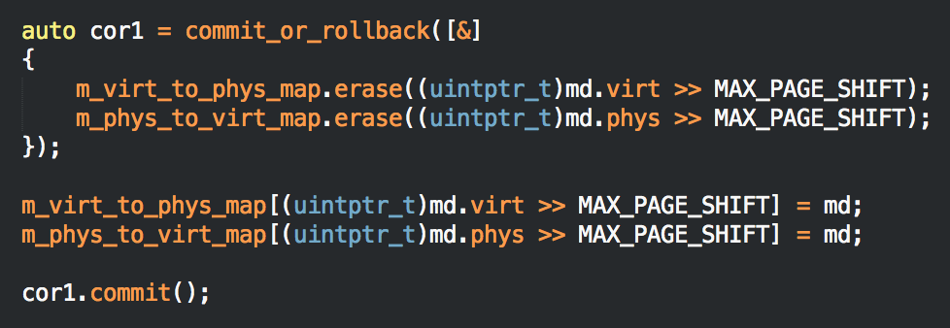
Why C++
STL
The C++ Standard Template Library (STL) provides Bareflank with generic library support for fast development and prototyping
In addition Resource Acquisition Is Initialization (RAII) provides for functionality like commit/rollback and mutex locker logic.

Slide 9
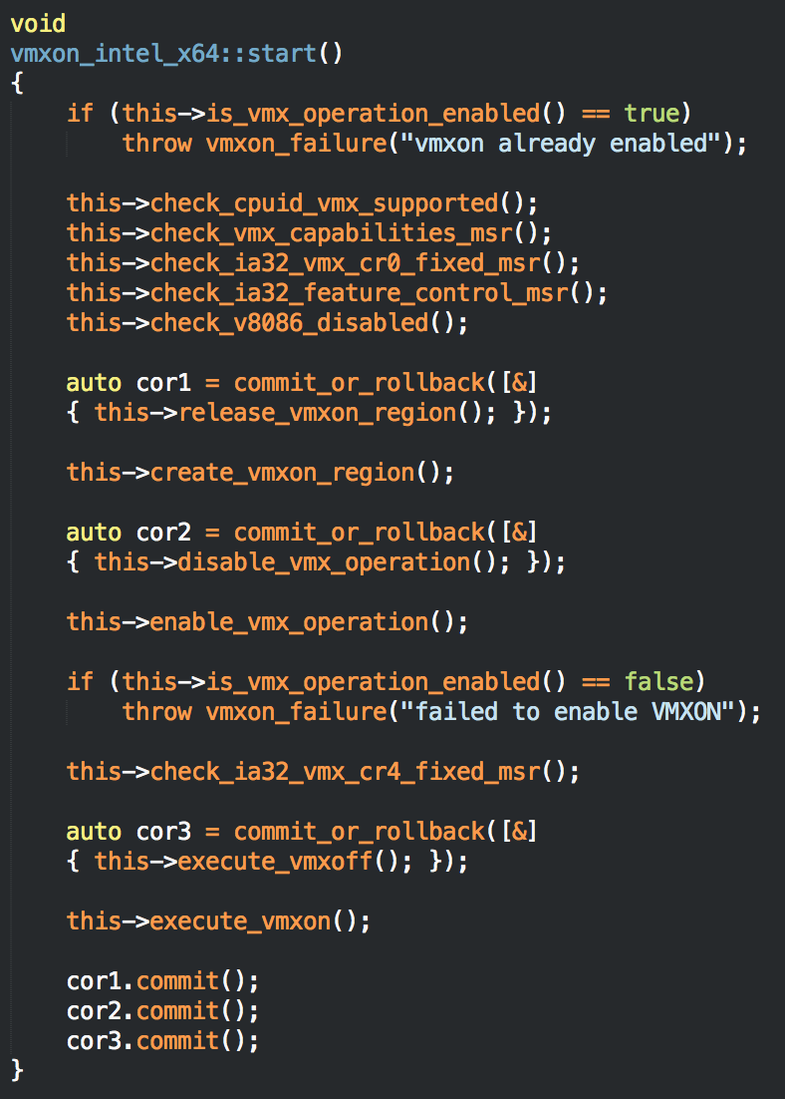
Why C++
Exceptions
Hypervisors have to deal with a lot of error checking / handling
C++ exception support greatly simplifies this process and results in easier to read code
Notes:
This is the code to enable VMXON, a process that is well documented in the Intel Manual. As shown, this code reads like the manual. Without exceptions, each one of these functions would have to be checked for errors and handled properly. In addition, RAII removes the need for complex goto statements to unravel state changes should an error occur.

Slide 10
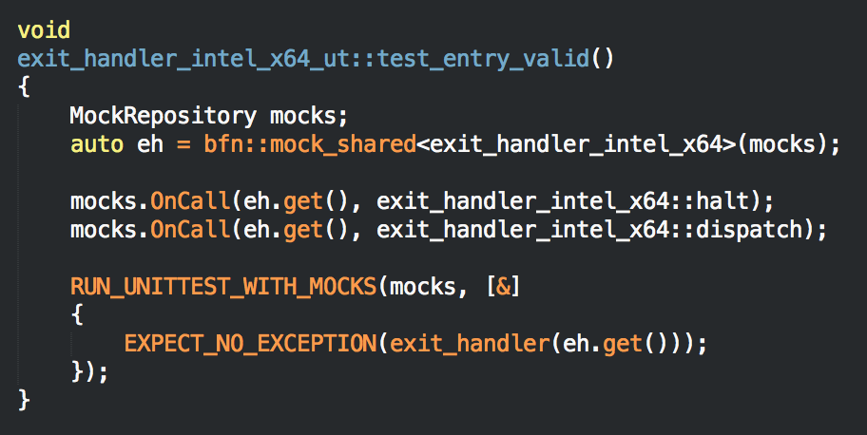
Why C++
Unit Testing
C++ has far superior unit testing frameworks than C. Bareflank uses Hippomocks (http://hippomocks.com)

Slide 11
High Level Architecture
Overview
BFM (user-space application) communicates with the drivers to start/stop hypervisor
Linux, Windows or OSX driver that uses a custom ELF loader to load the C++ VMM modules into the running kernel
Each module’s C runtime is executed by the driver to execute global constructors / destructors and register exception handling information
Kernel safe unwind library provides exception support

Slide 12
Cross Compiler Script
The VMM is compiled using a cross compiler (TARGET=x86_64-elf)
To create this cross compiler, Bareflank contains two scripts:
setup-<platform>.sh
create-cross-compiler.sh
The setup script is specific to the OS your using, and installs the packages needed to create the cross compiler.
The create script actually creates the cross compiler and it’s system root (i.e. libc / libc++)

Slide 13
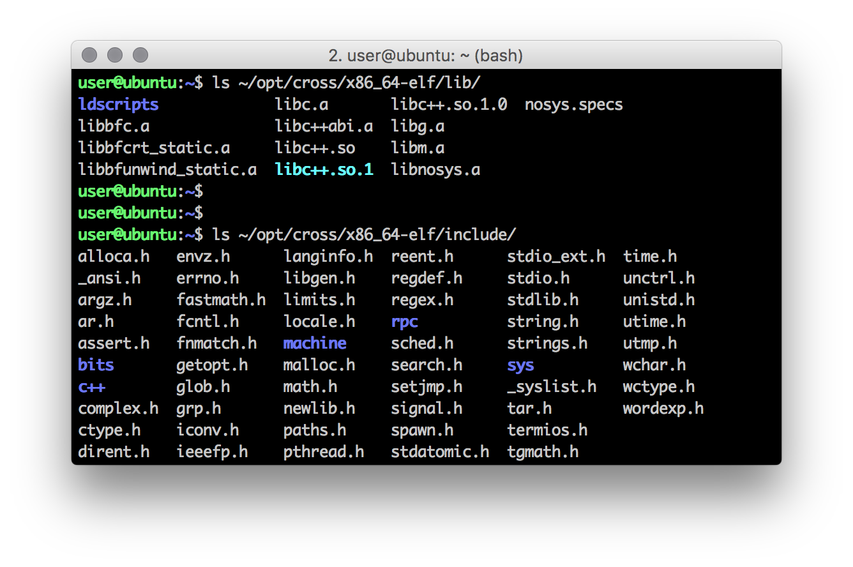
Cross Compiler Script
The sysroot contains all of the headers / libraries for libc and libc++

Slide 14
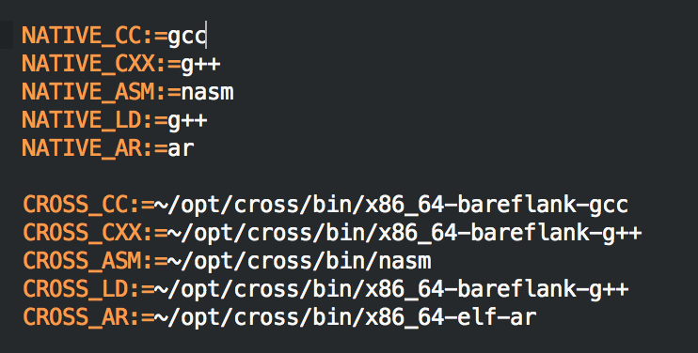
Build System
Native and Cross
The build system compiles most of the source code using both the system’s native compiler, and the cross compiler
The native compiler is used for BFM and unit tests, while the cross compiler is used for the VMM.

Slide 15
Build System
Flags
The main three flags that Bareflank uses (and will continue to need) are: -fpic, -ffreestanding and -mno-red-zone
In particular, -mno-red-zone prevents an issue with the System V spec that causes stack corruption in the kernel (real joy to track down )
http://eli.thegreenplace.net/2011/09/06/stack-frame-layout-on-x86-64/
http://wiki.osdev.org/Why_do_I_need_a_Cross_Compiler%3F#-mno-red-zone_.28x86_64_only.29

Slide 16
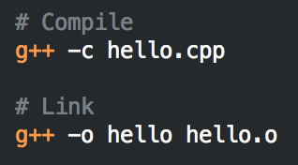
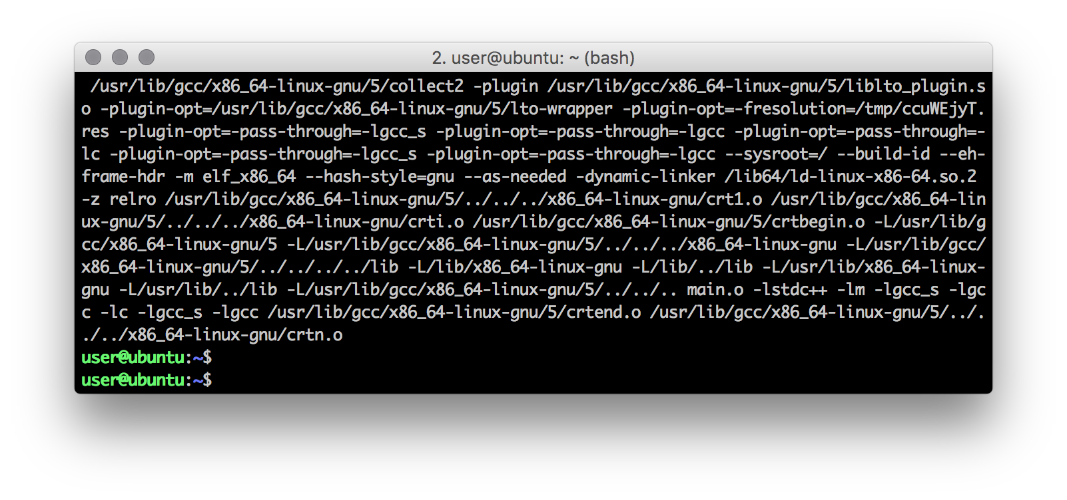
Wrapper Script
Under the Hood
When compiling and linking a program, you typically invoke the compiler twice. Once to compile the code, and once to link the compiled object files.
Under the hood GCC does this for you:

Slide 17

Wrapper Script
Options
The extra args are object / header files specific to your OS that are needed to link a program such that it can be run by your OS
Since Bareflank provides it’s own C runtime library and ELF loader, we were left with three possible options:
Patch GCC and Clang to provide the linker args as we need them (for every version of GCC and Clang we decide to support)
Run LD manually (ideal solution)
Create bash wrapper script for GCC/Clang that acts like GCC/Clang, but runs LD manually during linking

Slide 18
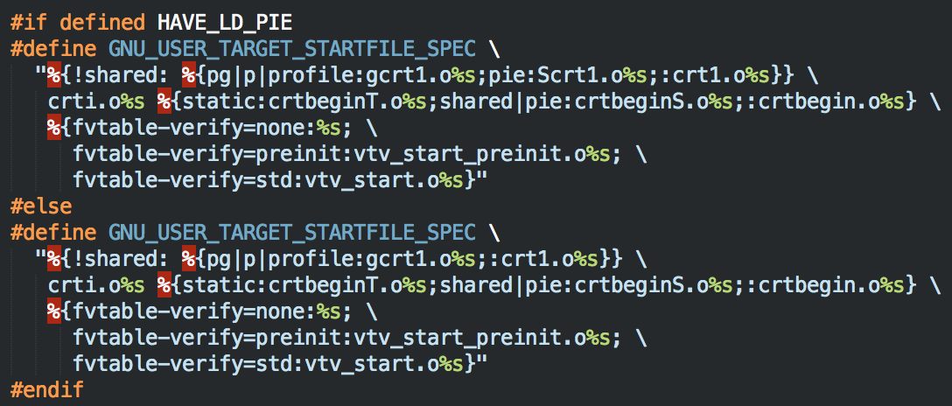
Wrapper Script
Patching GCC
Patching GCC would involve managing code like this for every version of GCC (not to mention Clang):
http://wiki.osdev.org/OS_Specific_Toolchain

Slide 19
Wrapper Script
Seriously?

Slide 20
Wrapper Script
Link Manually
Running LD manually was what we did at first until it came time to compile Libc++ which uses CMake.
CMake expects that you are using the compiler as the linker. In other words, CMake does not have a clean set of variables for the linker like it does for the compiler such as:
CMAKE_C_COMPILER
CMAKE_CXX_COMPILER
https://cmake.org/pipermail/cmake/2014-August/058268.html
One week later, we moved to option #3

Slide 21
Wrapper Script
Really?
One week later, we moved to option #3

Slide 22
Wrapper Script
Winning Option
Bareflank uses a bash script that mimics GCC (and eventually Clang). If “-c” is provided GCC/G++ is used, and LD is used otherwise.
No patches are needed to GCC or Clang, meaning Bareflank’s build environment works (so far) on all of the cross compilers we support without modifications (GCC 5.1, 5.2, 5.3 and 6.1)
Object files and header include paths are added to GCC/G++ and LD as needed
Ugly hacks are contained in one, easy to script place

Slide 23
Libc++
Options
With regards to the C++ STL, there are not many options (which we found surprising).
The two biggest libraries are Libc++ and Libstdc++
There are several other more esoteric implementations that have either been abandoned, or do not support C++11/C++14
Libstdc++ / libsupc++ (GNU’s library set) are almost impossible to build when not targeting a specific OS.
http://wiki.osdev.org/Talk:Libsupcxx

Slide 24
Libc++
Advantages
Libc++ / libc++abi (Apple’s C++ library set) on the other hand was:
Easy to compile (once we created the wrapper script)
Supports C++11 / C++14 and most of C++17
Can be compiled with and without threading support
Can be compiled with and without exception support
Works well with both GCC and Clang/LLVM
Supports the Newlib C library

Slide 25

Libc++
Disadvantages
Sadly libc++ / libc++abi are not perfect:
Some functions make heavy use of the stack. This is fine for sane operating systems like Windows and OSX, but Linux only has an 8k stack by default which causes issues.
Some functions (like the unordered_map hash function) use floating point arithmetic which is not supported in the kernel
Some functions use divide / modulo which is also not supported in the kernel
For these reasons, future versions of Bareflank will patch Libc++ to cleanup needed functionality

Slide 26
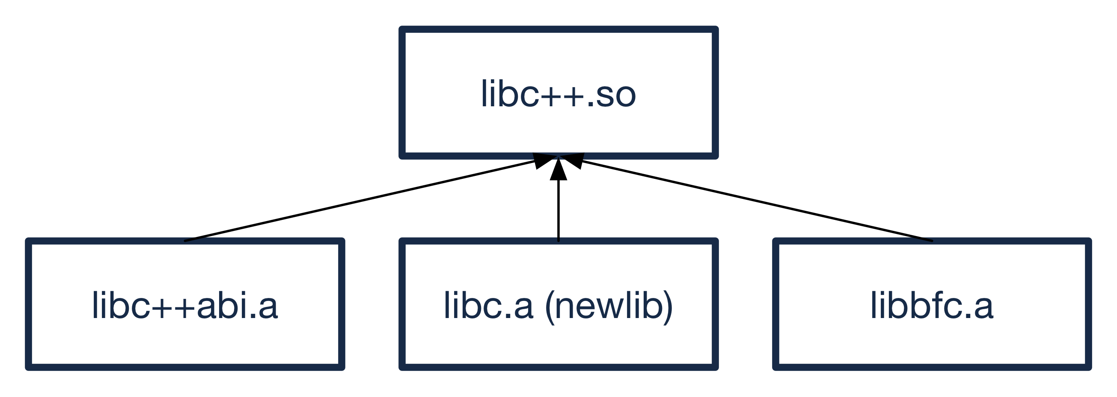
Libc++
Current Structure
Bareflank loads a library called libc++.so to get it’s C++ functionality.
This library actually consists of libc++, libc++abi, newlib and libbfc all compiled into a single shared library.

Slide 27
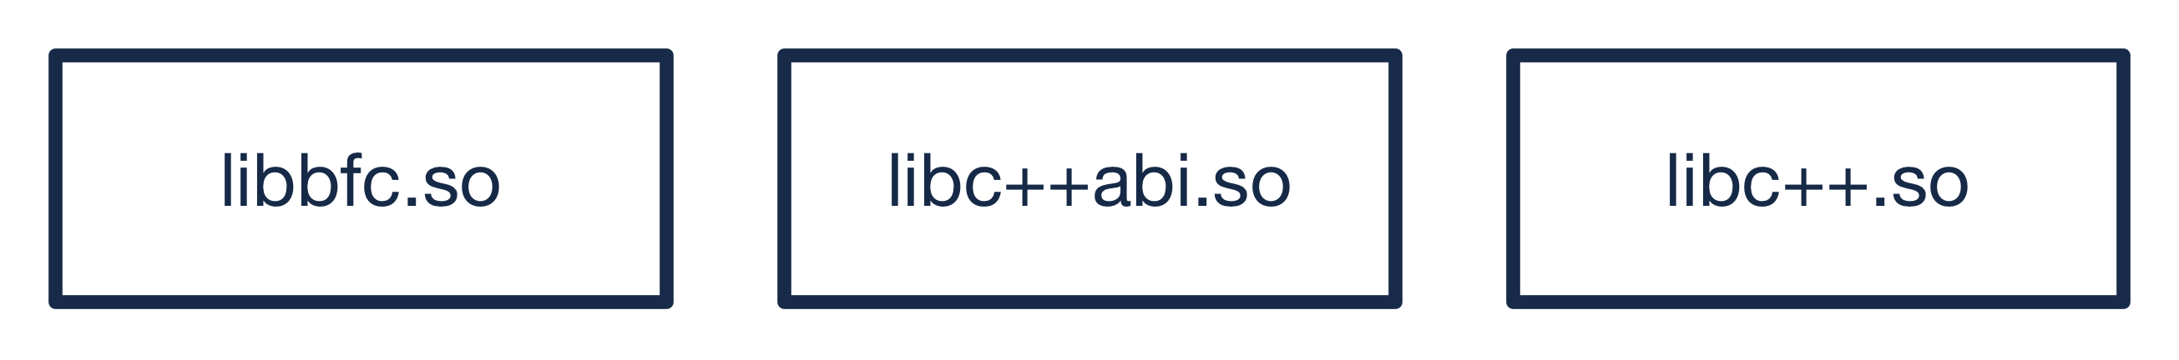
Libc++
Future Structure
The problem with this approach is some symbols are missing from libc++abi as it is statically linked.
To solve this, future versions of Bareflank will provide it’s own libc which will enable libc, libc++ and libc++abi to all be loaded as individual shared libraries

Slide 28
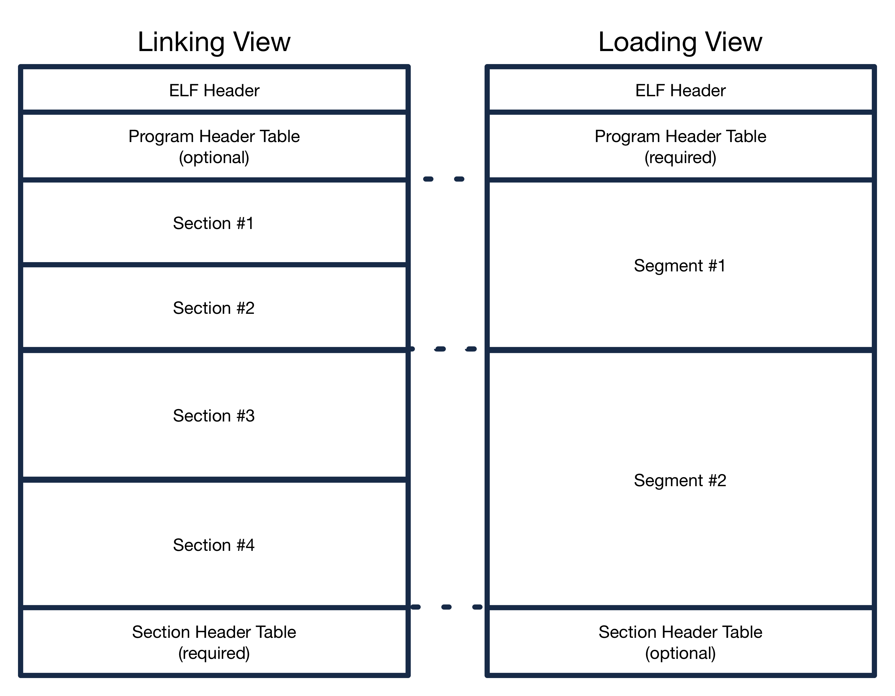
ELF Loader
Overview
Bareflank comes with a custom ELF loader to load the VMM into the running kernel

Slide 29
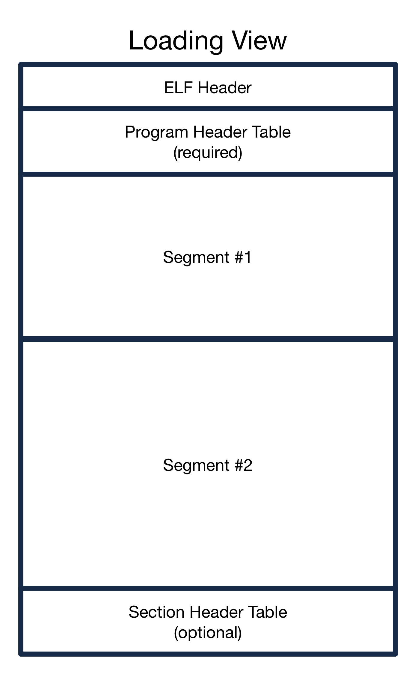
ELF Loader
Loading
In an ELF file, all of the sections are grouped into “segments” (also called program headers)
Each segment provides the ELF loader with instructions as to where to load the segment as well as what type of memory to load the segment into
For Bareflank, all of the modules have a ”R/W” and a “R/E” segment

Slide 30
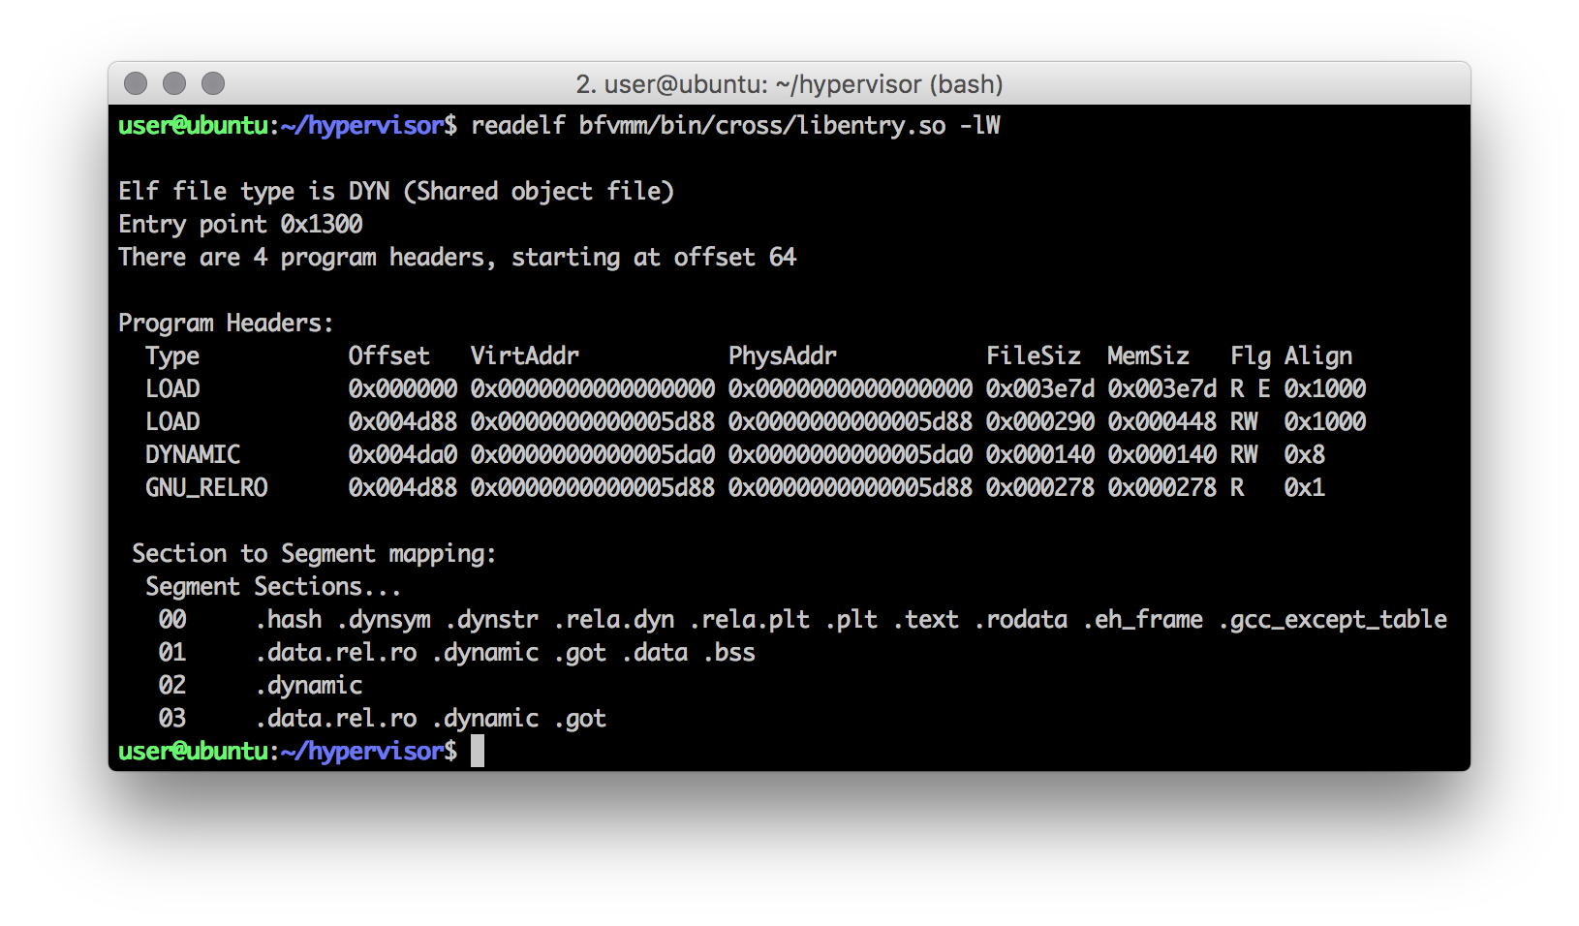
ELF Loader
Loading (continued)

Slide 31
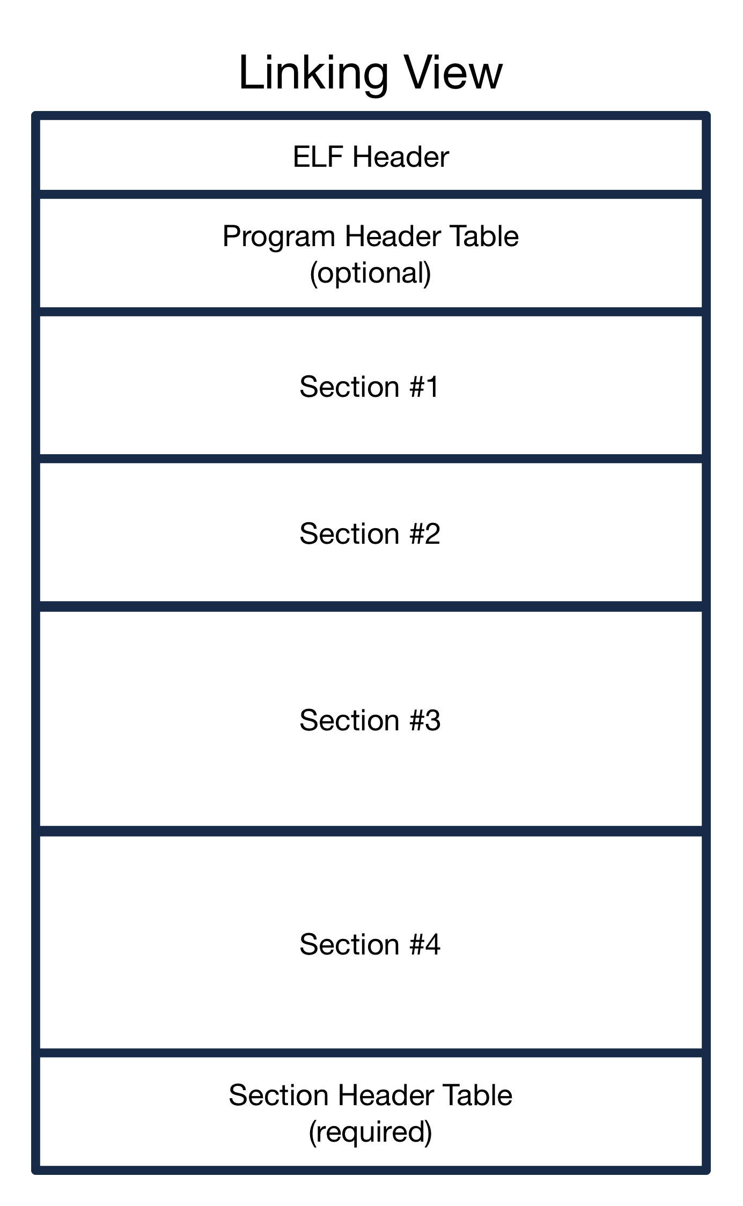
ELF Loader
Linking
Each ELF file is divided into a set of “sections”.
Each section provides different resources that are needed to execute the code in the ELF file
Examples include:
.text
.data
.dynamic
.ctors/.dtors
.eh_frame

Slide 32
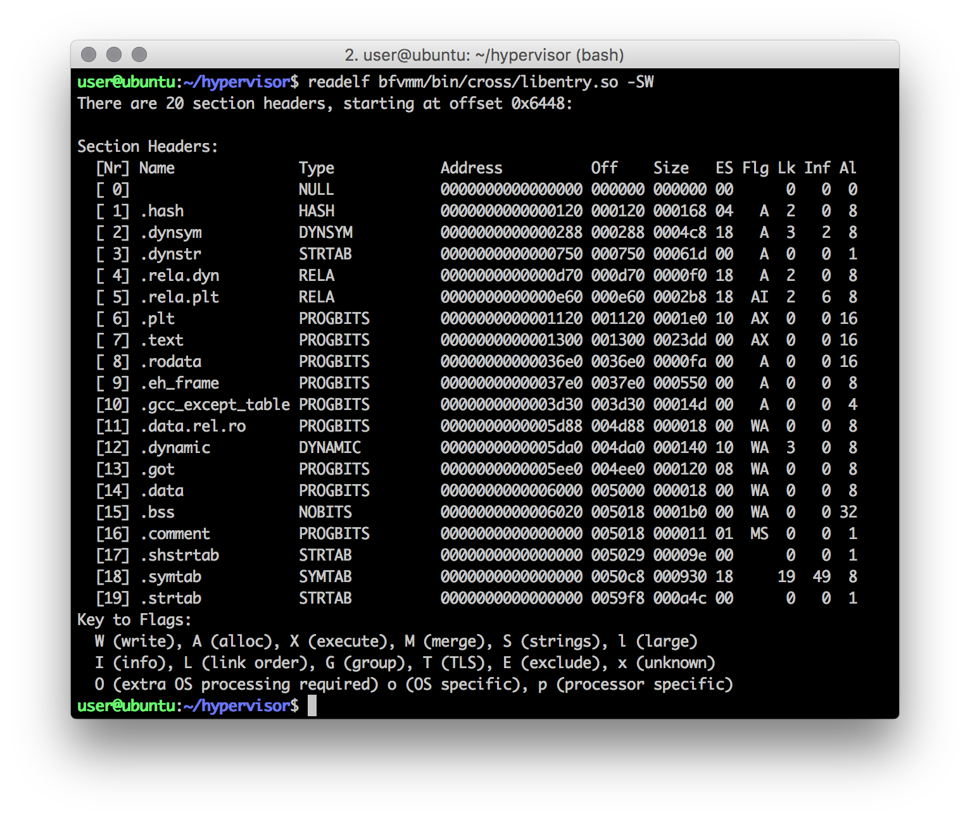
ELF Loader
Linking (continued)

Slide 33
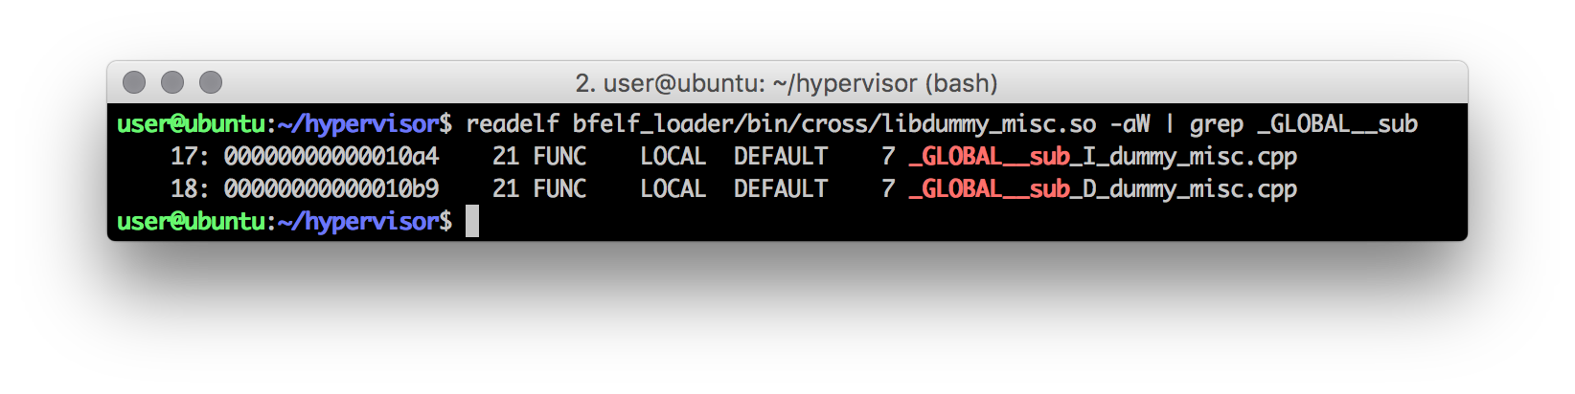
ELF Loader
Constructors / Destructors
To handle global constructor / destructors, each ELF file (that needs it) has a .ctor / .dtor section, or in the case of Clang / LLVM, a .init_array / .fini_array
These sections contain a table of void (*func)(void) functions. In most cases, only one function is present in each:

Slide 34
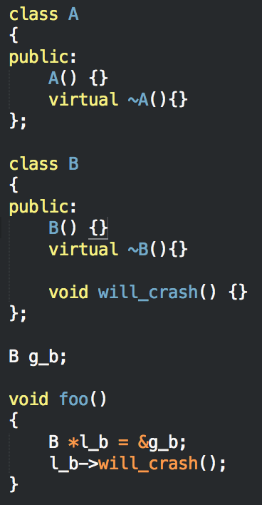
ELF Loader
Crash
These _GLOBAL__sub functions handle more than just ctor / dtor logic, but also include some relocations.
For example, this code will crash if the _GLOBAL__sub_I_xxx function is not executed.
To support the execution of the ctors/dtors fucntions, Bareflank provides a custom C Runtime Library called bfcrt

Slide 35
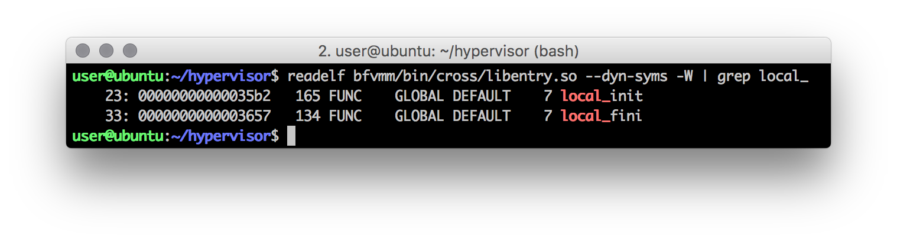
C Runtime Library
Init / Fini
The Bareflank C Runtime (bfcrt) provides two functions:
local_init
local_fini
This library is compiled as a static library and the GCC/G++ wrapper links this library with every shared library that it compiles and links

Slide 36
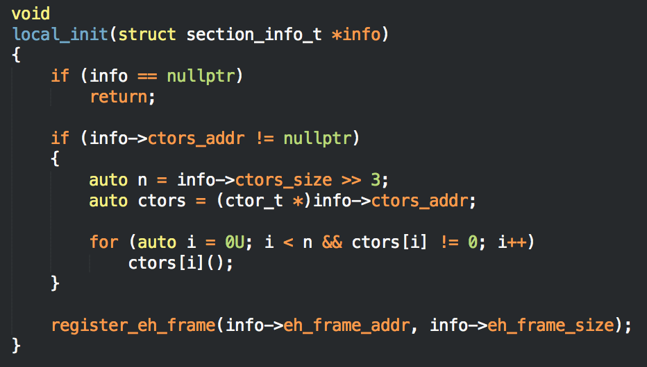
C Runtime Library
Init
Once each module is loaded and relocated using the ELF loader, each module’s local_init function is executed which runs the functions in the .ctor table

Slide 37
ELF Loader
Weak / Strong
The ELF loader must also deal with weak / strong symbols.
Some libraries provide functions (symbols) while other libraries consume (i.e. use) functions from other libraries.
The ELF loader must locate each function and provide every library that uses that function with it’s address (this is part of the relocation process)

Slide 38
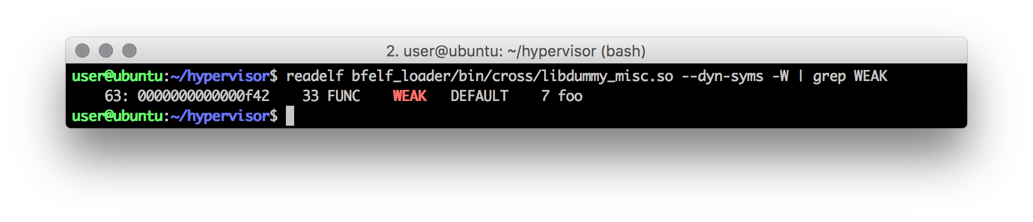
ELF Loader
Weak
What if the same function is defined twice?
In our case, we pick the first symbol we find. To help with this problem, ELF provides “weak” symbol support.
Using __attribute__((weak)), GCC will mark a function as weak, telling the ELF loader to pick the strong symbol over the weak symbol

Slide 39
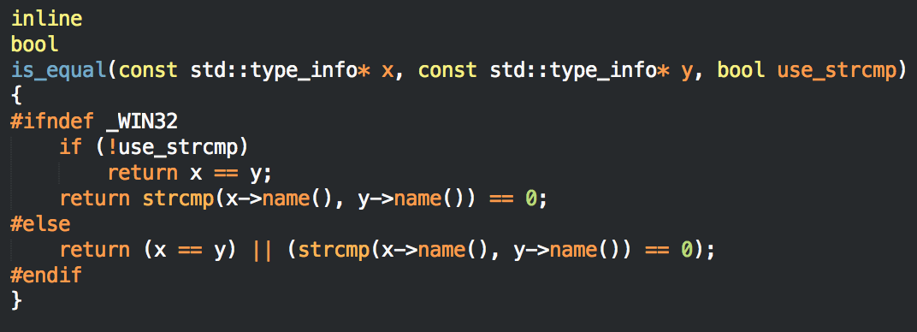
ELF Loader
dynamic_cast<>
What if every symbol is defined weak? Turns out the Itanium C++ ABI states that if this happens, you must use the same symbol for references in all libraries.
The reason for this is GCC marks all std::type_info symbols as weak and dynamic_cast relies on this when it is doing it’s pointer comparisons.

Slide 40

ELF Loader
Oops
https://llvm.org/bugs/show_bug.cgi?id=26785

Slide 41
Unwind Library
Overview
The unwind library’s job is to reverse the function stack, cleaning up each function as it goes (including destroying locally created C++ objects)

Slide 42
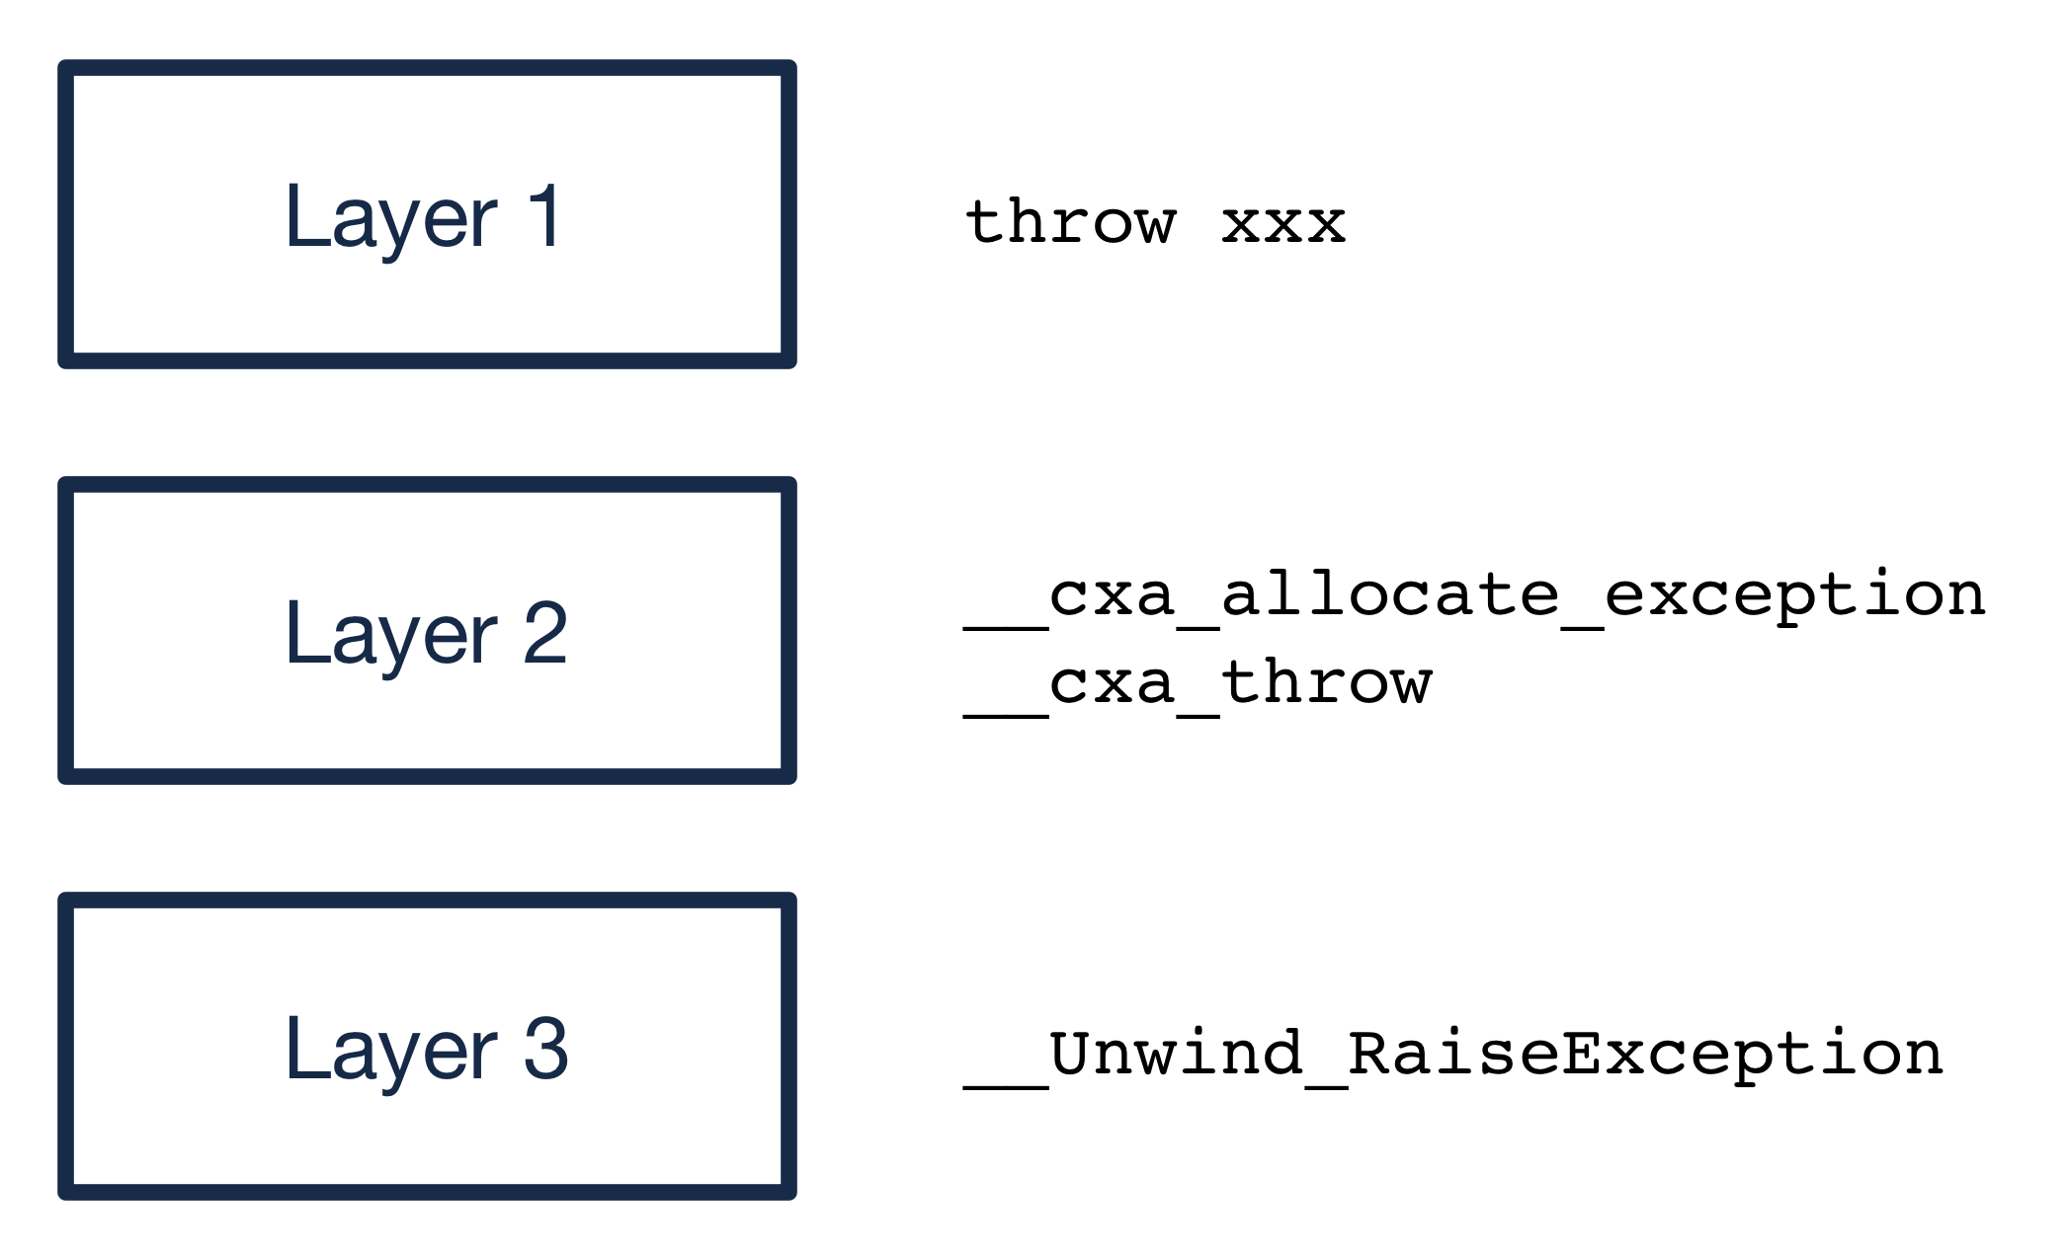
Unwind Library
Overview (continued)
C++ exception support is provided by three layers:

Slide 43
Unwind Library
Layer 1 / Layer 2
Layer 1 is provided by the C++ compiler itself. When you call “throw xxx” the compiler compiles this into a set of assembly instructions which result in a call to:
__cxa_allocate_exception
__cxa_throw
These __cxa_xxx functions are provided by Layer 2, which in this case is the libc++abi library.
http://libcxxabi.llvm.org/spec.html

Slide 44
Unwind Library
Layer 3
Layer 2 is architecture independent, yet C++ exceptions have to unwind the stack, which requires architectural knowledge.
To support this Layer 2 calls into Layer 3 functions, which on x86_64 is defined by the IA64 C++ ABI. https://mentorembedded.github.io/cxx-abi/abi.html
In this case, _Unwind_RaiseException is called which resides in the “unwind” library and actually performs the stack unwinding

Slide 45
Unwind Library
Why Custom?
Currently the three major libraries that provide Layer 3 support include:
Libgcc
Libunwind (Google)
Libunwind (Apple)
All three of these libraries are designed for user-space and thus rely on thread support, malloc/free, and various other libraries that are not available in our C++ environment
For these reasons, Bareflank provides a custom, kernel-safe, thread-safe unwind library

Slide 46
Unwind Library
Spec Complexity
The unwind library relies on several specs to work:
DWARF4: http://www.dwarfstd.org/doc/DWARF4.pdf
LSB: https://refspecs.linuxfoundation.org/LSB_5.0.0/LSB-Core-generic/LSB-Core-generic.pdf
IA64 C++ Spec: https://mentorembedded.github.io/cxx-abi/abi.html
System V Spec: http://www.x86-64.org/documentation/abi.pdf
In addition to the documentation in these specs, each header file in Bareflank’s unwind library is named after the spec it uses, and documents how it is used.

Slide 47
Unwind Library
Registering EH Frame
The process starts in bfcrt, were a call is made to register the “.eh_frame” location and size with the unwinder.

Slide 48
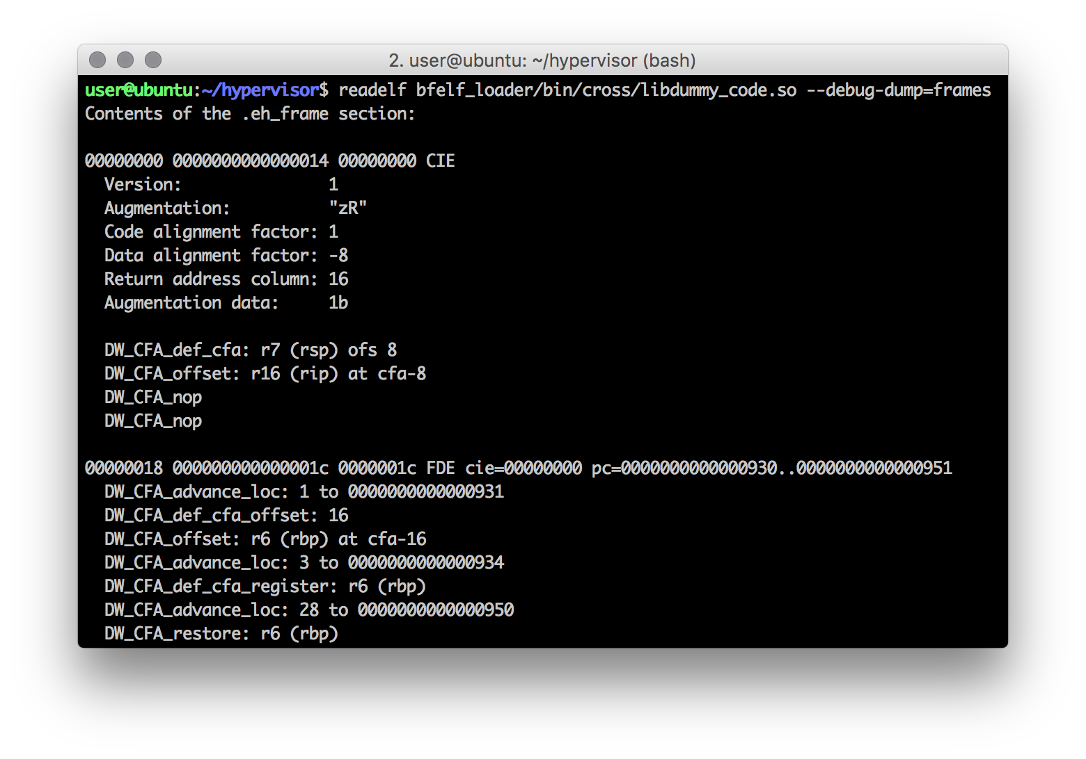
Unwind Library
DWARF4
The format of the information in “.eh_frame” is defined by the LSB and DWARF4 specs. This section stores the instructions on how to undo each stack frame in the code in a DWARF4 compressed format.

Slide 49
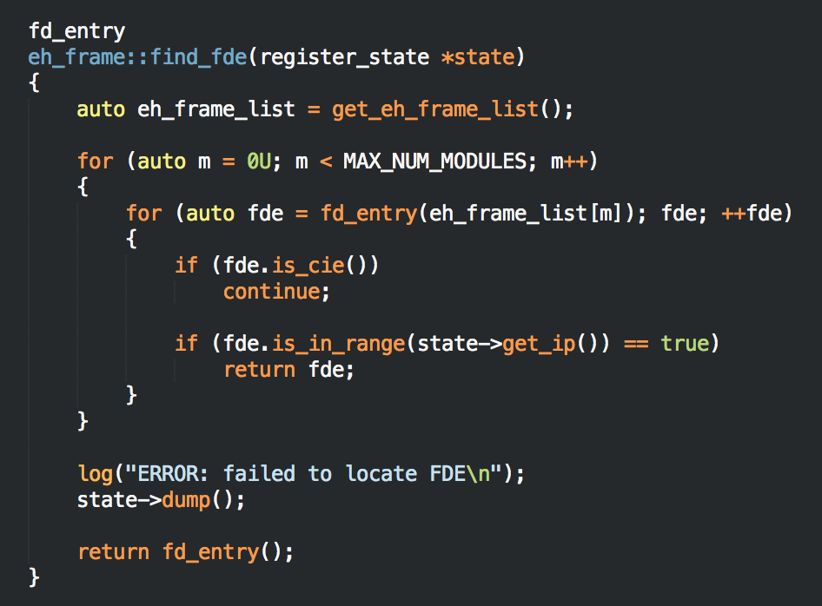
Unwind Library
Locate FDE
When an exception is thrown, the unwind library takes the current stack pointer and locates the stack frame information in “.eh_frame” for that pointer

Slide 50
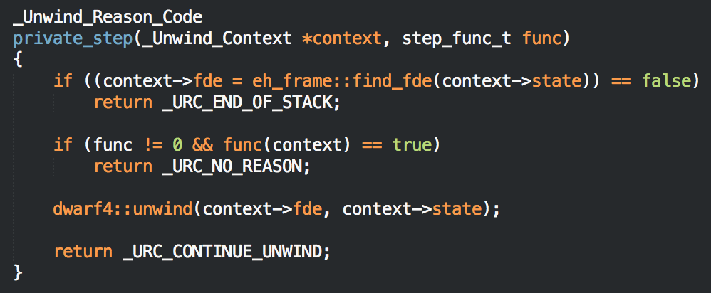
Unwind Library
Getting Next RIP
The unwind library uses this call frame information to unwind the stack, resulting in a new instruction pointer

Slide 51
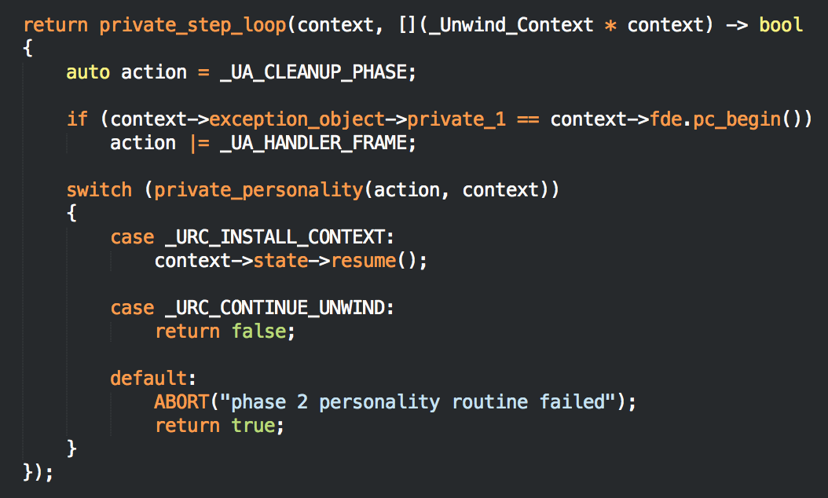
Unwind Library
Repeat Until Catch / RAII
This process is repeated until the “personality” function tells the unwind library to stop and resume (usually from a catch or RAII destructor).

Slide 52
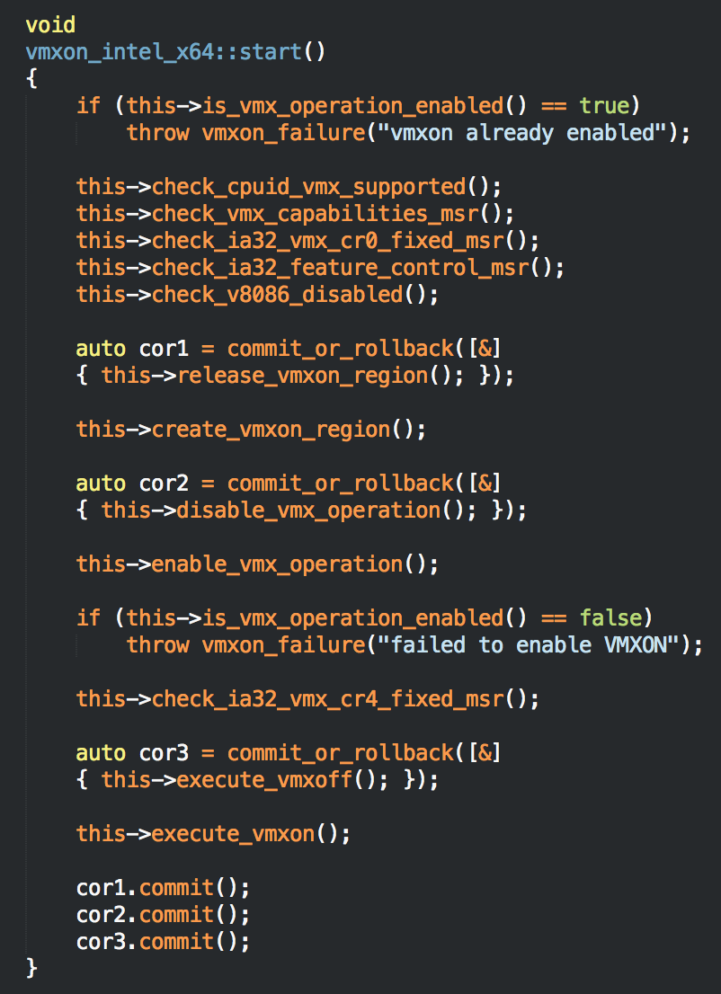
Commit / Rollback
Overview
Bareflank also provides a “commit or rollback” class that can be used to undo state changes (instead of using goto).
Simply define an instance of the class and provide the rollback code.
If commit is not called, when the instance is destroyed, the rollback code is called

Slide 53
Limitations
There are some limitations with Bareflank’s C++ environment:
There is no support for libc. This library only exists to support libc++ and future versions of Bareflank are likely to continue to remove libc functions over time
Not all C++ STL functionality is supported (e.g. fstream). Future versions will provide a unit test for C++ itself that will clearly define what is supported
Currently some C++ functionality is missing (e.g. unordered_map). Future versions will patch libc++ to provide this missing functionality
Support for C++14 / C++17 depends on the compiler you use (i.e. GCC 6.1 is needed for complete C++14 support)

Slide 54
Demo
Walk through VPID example

Slide 55
Demo
Walk through CPUID Count example

Slide 56

Questions

